Slide 1
Visitor Attraction Trends in England 2021
(6 top level take outs)

Slide 2
PROJECT BACKGROUND AND CONTEXT

Slide 3
PROJECT BACKGROUND
5,947 English visitor attractions were invited
  465 completed online
  343 completed by post
  561 provided data through umbrella organisations
979 attractions responded, were open in 2021 and provided also 2020 visitor numbers and these attractions form the basis of this report’s visitor trends evaluation.
Visitor Attraction Definition
The attraction must be
  a permanently established site
  allowing access for entertainment, interest, or education
  open to the public
  attracting day visitors or tourists as well as local residents
  a single business, under a single management, so that it is capable of answering the economic questions on revenue, employment etc.
2021 Context: COVID
England started 2021 with a third national lockdown with most visitor attractions required to close until mid-April, and legal limits on social contact not fully removed until 19th July.
Overseas visitors to the UK declined for a second year, due to the travel restrictions and reduced appetite for travel associated with COVID.

Slide 4
Fewer sites were closed throughout 2021 and fewer were closed for part of the year, compared to 2020. Top reasons for partial closures were regional lockdowns and not meeting Covid safety requirements
Closure due to… | 2020 [%] | 2021 [%]
Regional lockdown | 29 | N/A
Unable to meet COVID requirements on site | 17 | 9
Not profitable to open | 7 | 7
Insufficient staff/ volunteers | 6 | 7
Any refurbishment/ repairs | 7 | 11
Planned refurbishment/ repairs | Not asked | 9
Refurbishment/ repairs brought forward due to COVID | Not asked | 2
Other reason | 6 | 5
Source: Annual attractions survey, 2021 data

Slide 5
During 2021, attractions were running at the maximum capacity of 71%, based on the maximum capacity in 2019
 | Maximum capacity during 2021 as a % of the maximum capacity in 2019 [Mean score] | Maximum capacity by the end of 2020 as a % of the maximum capacity in 2019 [Mean score]
Total Average (609) | 71 | 49
Coastal (80) | 74 | 52
Rural (332) | 75 | 54
Urban (197) | 64 | 54
Source: Annual attractions survey, 2021 data

Slide 6
6 TOP LEVEL TAKE-OUTS

Slide 7
TAKE OUT 1
-------------------------------------
VISITOR VOLUME

Slide 8

Take out 1: 2021 saw the green shoots of recovery although visitor volume remained behind 2019 level
Admissions volume for participating attractions
(2020 and 2021 visitor volume was provided through the survey; 2019 visitor volume is an estimation based on the sector trend recorded in 2020)
 | 2019 | 2020 | 2021
Number of visits | 244.14 million | 85.45 million | 111.08 million
 | 2019 to 2020 | 2020 to 2021 | 2019 to 2021
Annual change in number of visits | -65% | +30% | -55%
Source: Annual attractions survey, 2021 data

Slide 9
The visitor volume index is showing that while there has been an increase in 2021 (compared to 2020), the level of visits volume is still well behind pre-pandemic levels 2019
Source: Annual attractions survey, 2021 data

Slide 10
TAKE OUT 2
-------------------------------------
GROSS REVENUE

Slide 11
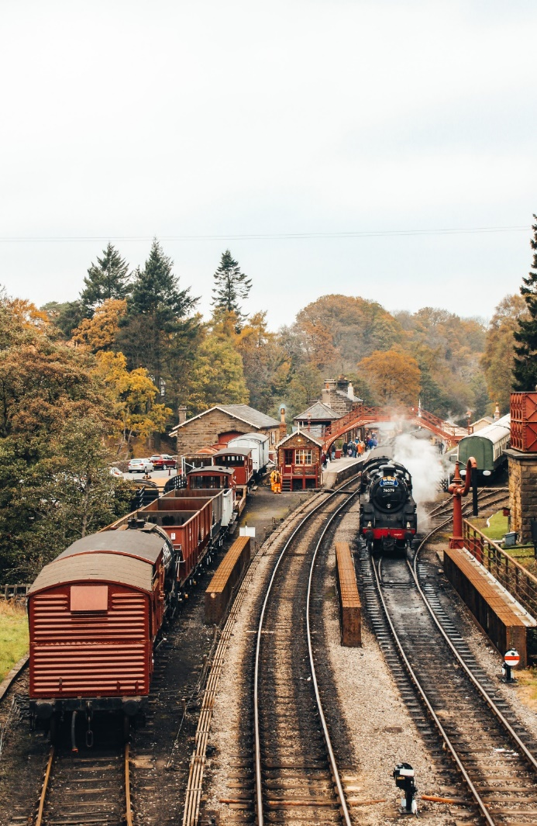
Take out 2: Gross revenue recovered faster than visitor volume
At an overall level, the gross revenue at visitor attractions increased by 92% in 2021, regaining some of the ground lost in 2020 when revenue declined by 55% on average.
Source: Annual attractions survey, 2021 data

Slide 12
The faster recovery of gross revenue was driven partly by the greater growth in visitor volume of paid attractions and partly by increase in entrance fees
Change in adult admission charge
Visitor Volume Trends 2021
 | 2020/2021 change [%] | 2019/2020 change [%]
Total Average | +30 | -65
Free (310) | +19 | -71
Paid (668) | +37 | -60
Source: Annual attractions survey, 2021 data

Slide 13
TAKE OUT 3
-------------------------------------
EXTRA FUNDING

Slide 14
Take out 3: Recovery in 2021 was supported by use of additional revenue streams
In total, 81% of attractions accepted donations in 2021.
Of the sites which accepted donations:
35% reported an increase in donations in 2021 vs 2019
39% reported a decrease in donations in 2021 vs 2019
26% reported donations being at similar levels
58% of sites qualified for gift aid, and this has remained an important revenue source in 2021.
62% of attractions secured similar or higher levels of gift aid compared to before the pandemic in 2019
68% of all attractions sought additional funding during 2021
45% were able to secure what they needed
20% were able to secure part of what we needed
4% were unsuccessful in securing funding
Source: Annual attractions survey, 2021 data

Slide 15
The funding sources that attractions have used most were: government funding, peer to peer lending and community shares
Source: Annual attractions survey, 2021 data

Slide 16
TAKE OUT 4
-------------------------------------
DIGITAL CONTENT

Slide 17
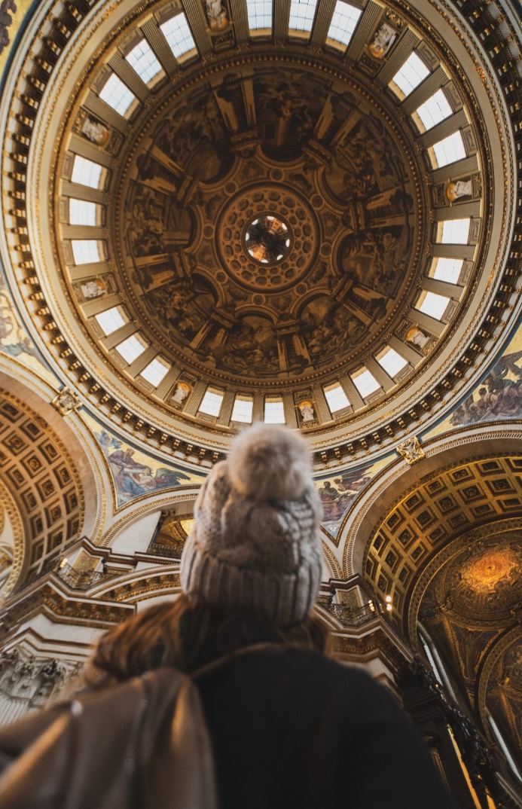
Take out 4: 66% of attractions developed (mostly free) digital content to engage with their audiences during the pandemic
Marketing & content that attractions put in place to engage with their audiences during the pandemic
[% of attractions introducing the specific content]
 | 2021 All sites | Free sites (361) | Paid sites (570)
Online tours/ video content - for free | 36 | 30 | 40
Home-schooling/ family content – for free | 30 | 24 | 33
Online learning (schools/adults) – for free | 26 | 21 | 30
Online tours/ video content – at a cost | 6 | 5 | 7
Home-schooling/ family content – at a cost | 3 | 2 | 4
Online learning (schools/adults) – at a cost | 9 | 7 | 10
Developed online retail offer | 32 | 19 | 39
Digitised collections | 25 | 19 | 29
Used augmented reality on site | 2 | 3 | 2
None of these | 34 | 35 | 33
Source: Annual attractions survey, 2021 data

Slide 18
The marketing activities helped the revenue growth in 2021
Provision of free content actually had more impact on revenue than paid content – most likely because this reached more people.
Impact of marketing activities on business performance
 | 2020-2021 change in gross revenue
 | Did offer | Did not offer
FREE online content | +122% | +75%
PAID online content | +81% | +76%
Developed online retail offer | +116% | +81%
Source: Annual attractions survey, 2021 data

Slide 19
TAKE OUT 5
-------------------------------------
STAFFING

Slide 20
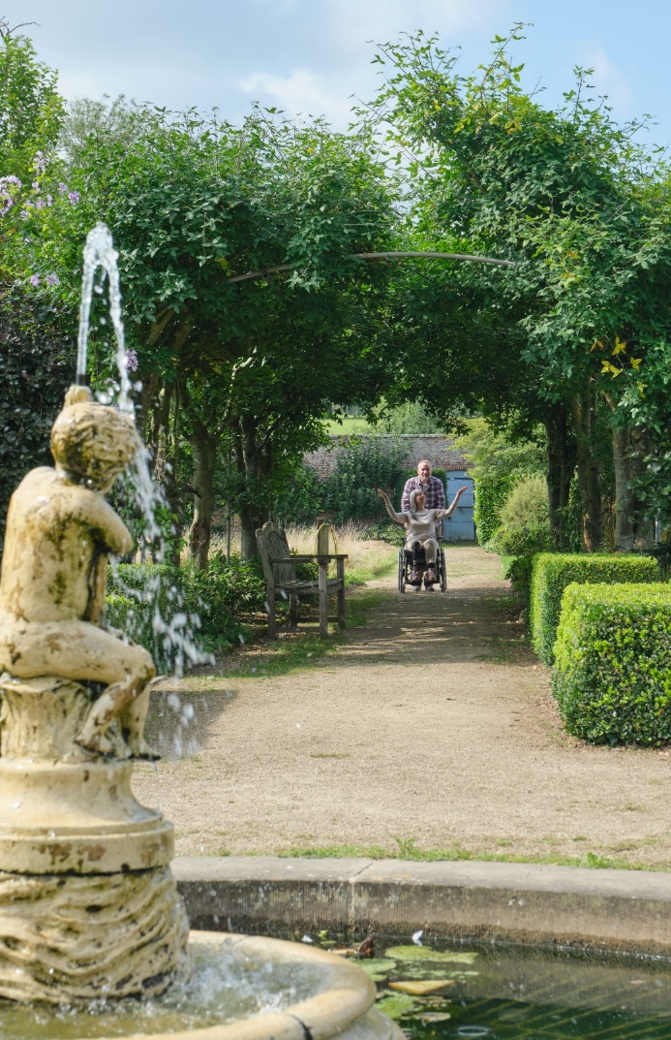
Take out 5: In 2021, permanent and seasonal staff levels remained consistent with 2020 … and so still below 2019 levels
NET change on the previous year
(‘up’ minus ‘down’)
2021 | 2020 | 2019
0% | -21% | +6%
+4% | -25% | +4%
+5% | -47% | +9%
… considering the increased visitor volume and greater maximum capacity reached in 2021 vs 2020, the lack of staff put pressure on attractions in 2021
Source: Annual attractions survey, 2021 data

Slide 21
TAKE OUT 6
-------------------------------------
SUSTAINABILITY

Slide 22

Take out 6: Sustainability is an important concern for attractions. 64% have an environmental business strategy or budget in place…
64%
Source: Annual attractions survey, 2021 data

Slide 23
… and most (84%) have taken some form of action to reduce carbon emissions
Source: Annual attractions survey, 2021 data

Slide 24
WILTSHIRE ATTRACTIONS LISTING

Slide 25
WILTSHIRE ATTRACTIONS
Rank | Name of Attraction | Category | 2019 Visitors | 2020 Visitors | 2021 Visitors | Exact or Estimate? | % Change 20-21 | % Change 19-21 | Charging?
1 | Longleat Safari & Adventure Park | Safari Park / Zoo / Aquarium / Aviary | 1011314 | 495037 | 727,800 | Not avail. | 47% | -28% | Yes
2 | Stonehenge | Historic Monument / Archaeological Site | 1604248 | 314999 | 334,087 | Exact | 6% | -79% | Yes
3 | Stourhead House and Garden | Historic House/ Garden / Palace | 392929 | 255761 | 320,521 | Exact | 25% | -18% | Yes
4 | Lacock Abbey, Grounds and Cloisters | Other Historic Property | 210709 | 106297 | 124,418 | Exact | 17% | -41% | Yes
5 | Salisbury Cathedral | Place of Worship (still in use) | Not avail. | 66300 | 84,921 | Not avail. | 28% | NA | Yes
6 | The Courts Gardens | Garden | 57366 | 30164 | 39,934 | Exact | 32% | -30% | Yes
7 | Avebury Manor and Garden | Historic House/ Garden / Palace | 129983 | 10705 | 36,338 | Exact | 239% | -72% | Yes
8 | Old Sarum | Historic Monument / Archaeological Site | 59330 | 30061 | 32,021 | Exact | 7% | -46% | Yes
9 | Old Wardour Castle | Castle / Fort | 28284 | 13066 | 24,859 | Exact | 90% | -12% | Yes
10 | Salisbury Museum | Museum and/ or Art Gallery | 28146 | 11766 | 18,792 | Exact | 60% | -33% | Yes
11 | Great Chalfield Manor | Historic House/ Garden / Palace | 21611 | 10888 | 17,770 | Exact | 63% | -18% | Yes
12 | Trowbridge Museum | Museum and/ or Art Gallery | Not avail. | 1898 | 9,503 | Exact | 401% | NA | No
13 | Mompesson House | Historic House/ Garden / Palace | 51920 | 1248 | 2,623 | Exact | 110% | -95% | Yes
14 | Calne Heritage Centre | Heritage / Visitor Centre | 3304 | 0 | 1,195 | Exact | NA | -64% | No
15 | Aldbourne Heritage Centre | Heritage / Visitor Centre | Not avail. | Not avail. | 602 | Exact | NA | NA | No
16 | Mere Museum | Museum and/ or Art Gallery | Not avail. | 100 | 50 | Estimate | -50% | NA | No
Source: Annual attractions survey, 2021 data
Listing attractions which responded to the survey and gave permission to publish their data

Slide 26
DOMESTIC SENTIMENT & INTENT
(1ST WEEK OF SEPTEMBER)

Slide 27
Perceptions of the situation relating to cost of living crisis are worsening with 80% of UK adults think ‘the worst is still to come’
22nd June: UK inflation
rose to 40-year
high of 9.1%
20th July: Fuel, milk
and eggs steepest increases in 40 years
17th August: UK inflation
up to 10.1%, shoppers
feel the inflation hit
Question: Q7b: And now regarding the ‘cost of living crisis’ in the UK and the way it is going to change in the coming few months, which of the following best describes your opinion? Base: All respondents. September 2022 = 1,758

Slide 28
25% of UK adults have been hit hard and had to cut back on spending. Fewer say they are ‘alright’.
Question: Q17: There has been a lot of talk about how the ‘cost of living crisis’ has affected people’s financial circumstances. If you had to choose, which ONE of the following statements would best describe your feelings about your own situation, right now? Base: All respondents. September 2022 = 1,758

Slide 29
Intentions for domestic overnight trips over the next 12 months are fairly stable, in line with last months’ intentions.
Question: QVB2a. Thinking of your next UK holiday or short break, when are you likely to go on this trip? QVB2b. And when else do you anticipate going on a UK holiday or short break? Base: All respondents. August 2022 = 1,759, September 2022 = 1,758 Note: Multiple choice question. Totals may exceed 100% as some respondents anticipate taking multiple trips across several time periods.

Slide 30
Visiting cultural attractions and heritage sites are in the top 4 activities for the next overnight domestic trip.
Question: VB6fiii. Which, if any, of these activities are you likely to do on your next UK short break or holiday in <INSERT MONTH FROM VB2A>?
Base: All July respondents planning on taking a holiday or short break in the UK between October to December 2022 n = 419, January to March 2023 n = 171. Note: Multiple choice question. Totals may exceed 100%.

Slide 31
21% are concerned about the cost of visitor attractions
Question: VB7bii. Which, if any, of these costs are the main financial barriers to you taking a UK short break or holiday in the next six months?
Base: August 2022 = 1759, September 2022 = 1758.

Slide 32
On their next overnight domestic trip, 36% of UK adults say they will ‘choose cheaper accommodation’ and 34% will ‘spend less on eating out’ and 34% will ‘look for more free things to do’.
Question: VB7c. How, if at all, would you say the ‘cost of living crisis’ is likely to influence your UK short breaks or holidays in the next six months?
Base: September 2022 = 1758.

Slide 33
On their next day trip, 34% of UK adults say they will ‘look for more ‘free’ things to do’ on their day trips. 32% will ‘take fewer day trips and 30% will ‘spend less on eating out’.
Question: VB7Cii. How, if at all, would you say the ‘cost of living crisis’ is likely to influence your day trips in the next few months?
Base: September 2022 = 1758.

Slide 34
THANK YOU!

Slide 35
Links to reports and listings
Annual attractions survey
Full report is accessible on our website along with the full listings and top 20 attractions per region:
https://www.visitbritain.org/annual-survey-visits-visitor-attractions-latest-results
You can also use the direct link to the report: https://www.visitbritain.org/sites/default/files/vb-corporate/2022-09-06_england_attractions_2021_trends_report.pdf
Page with previous reports (archive, for reference) is here: https://www.visitbritain.org/annual-survey-visits-visitor-attractions-archive
Domestic Sentiment Tracker
https://www.visitbritain.org/domestic-sentiment-tracker

